Slide 1
Quiz generator User Manual
Author:Ghadia Imran

Slide 2
Table of content
1 AI App/ Project Name
2 Acknowledgements
3 About Me
4 About My Internship Journey with Clevered
5 About App
6 Option Name
7 Demo Vi
8 Toolkit Walkthrough
9

Slide 3
Acknowledgements
Thank you to my older siblings for helping me make my project without any complaints

Slide 4
About Me
My name is Ghadia I am ten years old and currently I am in grade 6

Slide 5
About My Internship Journey with Clevered
My experience with clevered has been great the teachers are very sweet and will explain anything if not understood and do not leave any one behind

Slide 6
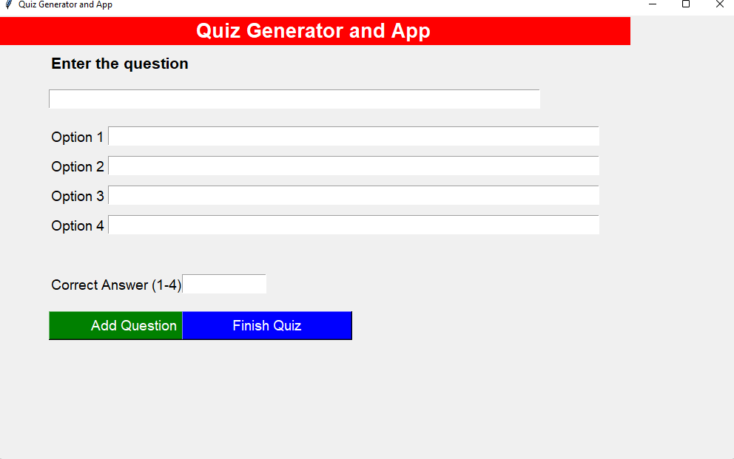
About App
My app name is Quiz generator in the app you write down a few questions and there are 4 options 3 incorrect and one correct below the options there is a place to write down the real answer.

Slide 7
How do I use the App?

Slide 8
Option Name
In the quiz generator you have to write down a question and it’s options 1 correct rest incorrect and below the the options we write down the correct option.

Slide 9
Demo Video

Slide 10
Toolkit Walkthrough
https://docs.google.com/spreadsheets/d/1PQ2tZSZL_ow3xyFFm4cZ9_oe_x_WrpDD/edit?usp=sharing&ouid=108898027166531926116&rtpof=true&sd=true

Slide 11
Contact Person
m.ghafran11@gmail.com

Slide 12
Thank you!

